Slide 1
5MS Market Settlement Reconciliation Session
Wednesday, 15 September 2021
This meeting is recorded for the purpose sharing with Market Participants for in-house training.
Please disconnect from your workplace VPN for the WebEx call

Slide 2
This meeting is being recorded
This meeting has been recorded and will be available for participants to access on the Participant Toolbox > Factsheet section of the 5MS website soon.

Slide 3
AEMO Competition Law
Meeting Protocol
AEMO is committed to complying with all applicable laws, including the Competition and Consumer Act 2010 (CCA). In any dealings with AEMO regarding proposed reforms or other initiatives, all participants agree to adhere to the CCA at all times and to comply with this Protocol. Participants must arrange for their representatives to be briefed on competition law risks and obligations.
Participants in AEMO discussions must:
Ensure that discussions are limited to the matters contemplated by the agenda for the discussion
Make independent and unilateral decisions about their commercial positions and approach in relation to the matters under discussion with AEMO
Immediately and clearly raise an objection with AEMO or the Chair of the meeting if a matter is discussed that the participant is concerned may give rise to competition law risks or a breach of this Protocol
Participants in AEMO meetings must not discuss or agree on the following topics:
Which customers they will supply or market to
The price or other terms at which Participants will supply
Bids or tenders, including the nature of a bid that a Participant intends to make or whether the Participant will participate in the bid
Which suppliers Participants will acquire from (or the price or other terms on which they acquire goods or services)
Refusing to supply a person or company access to any products, services or inputs they require
Under no circumstances must Participants share Competitively Sensitive Information. Competitively Sensitive Information means confidential information relating to a Participant which if disclosed to a competitor could affect its current or future commercial strategies, such as pricing information, customer terms and conditions, supply terms and conditions, sales, marketing or procurement strategies, product development, margins, costs, capacity or production planning.

Slide 4
Agenda
This meeting is being recorded
# | Timing | Subject | Presenter
1 | 11:00 – 11:10 | Introduction | Greg Minney
2 | 11:10 – 11:20 | Background on impact of 5MS & GS soft-start on settlement reconciliations | Blaine Miner
3 | 11:20 – 11:40 | Overview of RM Reports | Paul Lyttle
4 | 11:40 -11:50 | RM reports for the transition week | Paul Lyttle
5 | 11:50 – 12:00 | Profiling Interval Metering Data | Paul Lyttle
6 | 12:00 – 12:10 | Known Defects | Simon Tu
7 | 12:10 – 12:30 | Q&A | Greg Minney
8 | 12:20 | Meeting Close | Greg Minney

Slide 5
Introduction
Greg Minney

Slide 6
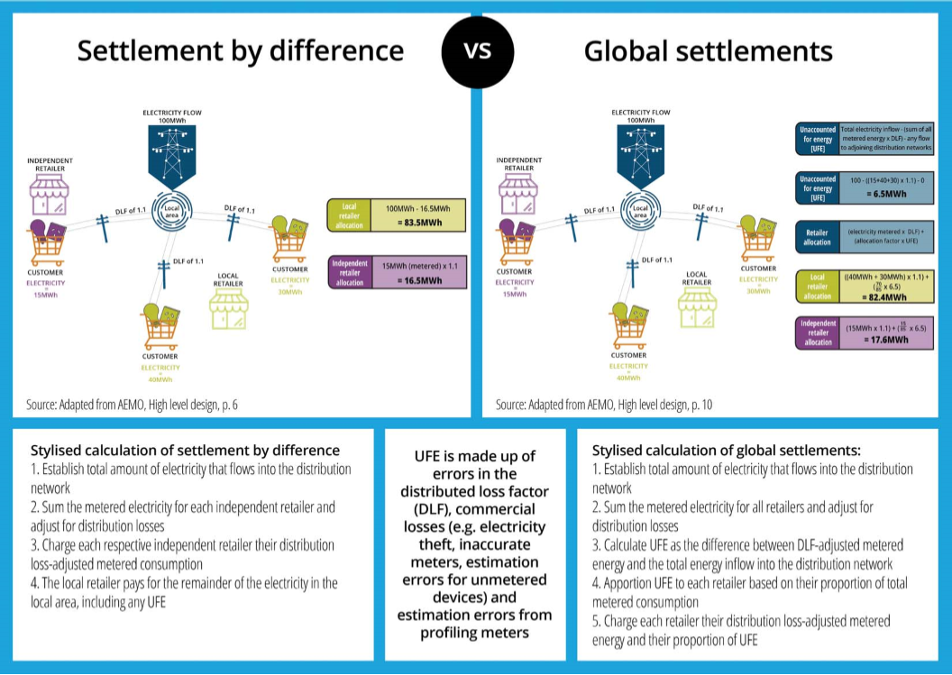
Market Reform
This meeting is being recorded
Five-minute Settlement
From 1 October 2021 the market will convert from a 30min market to a 5min market
Global Settlements
From 1 October 2021 UFE load values will be published by AEMO
From 1 May 2022 UFE will be financially settled by AEMO

Slide 7
Background on impact of 5MS & GS soft-start on settlement reconciliations
Blaine Miner

Slide 8
So what does this all mean for Market Settlements?
This meeting is being recorded
From 1 October 2021:
  The market will be settled at 5min trading intervals
    Various RM reports will need to be changed to reflect and support this reform, including:
      Increasing trading intervals from 48 to 288, where applicable
      Introducing 5min load profiles to support the profiling of 15 and 30min interval metering data
  UFE load values will be published by AEMO in the Settlement Reports
    New RM reports will be introduced to allow market participants to reconcile and understand these new values
From 1 May 2022:
  UFE will be financially settled by AEMO
    No new RM reports required, as they would have been introduced as part of the GS soft start on 1 October 2021

Slide 9
Market Reconciliation
This meeting is being recorded
Which Participant roles may choose to reconcile AEMO’s Settlement Reports?
  Financially Responsible Market Participants (FRMP)
    Retailers, Generators and Market Customers
Why do Participants reconciliation AEMO’s Settlement Reports?
  Reasons vary depending on the Participant
    To ensure they are paid or charged correctly
    To ensure their standing data and metering data aligns to the market
      Standing data and metering data is the foundation of several core activities for several market participants, including:
        Load forecasting
        Financial reporting
        Trading Performance reporting

Slide 10
Focus for the workshop
This meeting is being recorded
Highlight changes and new reports being introduced for 5Ms and GS
Outline the start to 5MS and the “transition Week”
Provide an opportunity to ask any outstanding questions

Slide 11
Notes
This meeting is being recorded
In response to questions asked, AEMO confirmed that:
  Baseline and demand response energy associated with Wholesale Demand Response (WDR) will not be included in RM reports. RM reports will continue to only include meter energy and profile data values.
  In relation to WDR, UFE will be calculated as per the Global Settlement Rule requirements i.e. will not be based on baseline or demand response energy values

Slide 12
Overview of RM reports
Paul Lyttle

Slide 13
Overview
This meeting is being recorded
The key RM reports which supports 5min & Global settlements reconciliations are:
    Level 1 Reconciliation report (RM16)
    Level 2 Reconciliation report (RM27)
    Level 3 Reconciliation report (RM17)
    PPS report (RM20)
    UFE Factor Values by Local Area (RM43)
    UFE Validation report (RM46)

Slide 14

RM16 – Level 1 Settlement Reconciliation
This meeting is being recorded
What is the report?
  The Level 1 Settlements Reconciliation report provides aggregated settlement data for:
    Each trading interval for each settlement day for the settlement week for all aggregated NMIs
      Grouped by:
        TNI
        DataType (C – Consumption or I – Interval)
        FRMP
        LR
        MDP
  This report is automatically created and sent to responsible participants on AEMO approval of the settlement case
What is changing for 5MS?
  Increase in the number of Trading Intervals from 48 (Period01 to Period48) to 288 (Period001 to Period288)

Slide 15
RM27 – Level 2 Settlement Reconciliation
This meeting is being recorded
What is the report?
  The Level 2 Settlements Reconciliation report provides:
    Daily aggregated settlement data for each NMI that was used during a settlements run
      Grouped by:
        TNI
        LR
        MDP
        NMI
  This report can be subscribed to and will be created and sent to responsible participants on AEMO approval of the settlement case.
    Non subscribed participants can request the report (RM21) once the RM16 report has been received
What is changing?
  Inclusion of the MDP Version Date Time for the reads used in the settlement case, to allow for easier identification of the applicable meter read version

Slide 16
RM17 – Level 3 Settlement Reconciliation
This meeting is being recorded
What is the report?
  The Level 3 Settlements Reconciliation report provides:
    Interval data for all suffixes of a particular NMI that was used during a settlements run
  This report can be manually requested for each NMI once the RM16 report has been received
What is changing?
  Increase in the number of Trading Intervals from 48 (Period01 to Period48) to 288 (Period001 to Period288)
  Inclusion of the MDP Version Date Time for the reads used in the settlement case, to allow for easier identification of the applicable meter read version

Slide 17

RM20 PPS (Profile Shape)
This meeting is being recorded
What is the report?
  The Profile Shape report provides profile data for:
    Each trading interval for each Profile load type for each profile area for the settlement case
  This report can be subscribed to and will be created and sent to responsible participants on AEMO approval of the settlement case.
    Non subscribed participants can request the report once the RM16 report has been received
What is changing?
  Increase in the number of Trading Intervals from 48 (Period01 to Period48) to 288 (Period001 to Period288)
  New 5MLP profile for each Trading Interval
    This new profile is used to provide 15- and 30-minute interval reads to 5-minute trading Intervals, this will be discussed in more detail later in the agenda
For information on understanding load profiles, please refer to:
  https://www.aemo.com.au/-/media/files/stakeholder_consultation/consultations/nem-consultations/2019/5ms-metering-package-3/final/understanding-load-profiles-from-msats-final-clean.pdf

Slide 18
RM25 Profile Shape Data
This meeting is being recorded
What is the report?
  The Profile Shape Data report provides profile data for:
    Each trading interval for each Profile load type for the settlement week where the Profile has been locked.
      The locking of Profiles usually occurs 15 weeks after the settlement week.
  This report is published to the AEMO website for each locked period.
What is changing?
  Increase in the number of Trading Intervals from 48 (Period01 to Period48) to 288 (Period001 to Period288)
  New 5MLP profile for each Trading Interval
    This new profile is used to provide 15- and 30-minute interval reads to 5-minute trading Intervals
For information of locked profiles, please refer to:
  https://www.aemo.com.au/energy-systems/electricity/national-electricity-market-nem/data-nem/metering-data/load-profiles

Slide 19

RM43 UFE Factor Values by Local Area
This meeting is being recorded
What is the report?
  The UFE Factor Values by Local Area report provides profile data for:
    A Usage Factor for each trading interval for each Local area for the settlement case
    This is a new report that can be used by Participants to calculate the UFEA value for any Local Area load
    The factor can be applied to each trading interval load to calculate the UFEA
  This report supports Clause 3.15.4 of NEM Global settlement Rule change
  This report can be subscribed to after the 1 October 2021 and will be created and sent to responsible participants on AEMO approval of the settlement case.
    Non subscribed participants can request the report once the RM16 report has been received
What is changing?
  This is a new RM report to support UFE reconciliation
For information regarding how AEMO calculates UFE values, please refer to:
  https://www.aemo.com.au/-/media/files/electricity/nem/5ms/program-information/2020/5ms-and-gs-reconciliation-support-workshop-2-18-nov-19.pdf?la=en

Slide 20
RM46 UFE Validation
This meeting is being recorded
What is the report?
  The UFE Validation report provides profile data for:
    Values used to calculate the UFE and Usage Factor for each trading interval for each Local area for the settlement case
    This is a new report that can be used by Participants to validate the UFE calculation and calculate the UFEA value for any Local Area load.
    The factor can be applied to each trading interval load to calculate the UFEA
  This report supports Clause 3.15.5 of NEM Global settlement Rule change
  This report can be subscribed to after the 1 October 2021 and will be created and sent to responsible participants on AEMO approval of the settlement case.
    Non subscribed participants can request the report once the RM16 report has been received
What is changing?
  This is a new RM report to support UFE reconciliation
For information regarding how AEMO calculates UFE values, please refer to:
  https://www.aemo.com.au/-/media/files/electricity/nem/5ms/program-information/2020/5ms-and-gs-reconciliation-support-workshop-2-18-nov-19.pdf?la=en

Slide 21
Notes
This meeting is being recorded
In response to questions asked, AEMO confirmed that:
  RM21 and RM27 are both Level 2 Reconciliation reports, however:
    RM21 reports are manually requested, or by subscription, and provide the daily totals of load data for each TNI’s (supplied as an input) NMIs. The NMIs returned are restricted to those NMIs that have the same ENLR that was supplied as an input to this report. The output can also be further restricted to those NMIs with a certain MDP
    RM27 reports are automatically sent out to effected Participants on Settlement Case Approval, these report will provide the daily totals of load data for all NMIs for all TNI combinations for all MDPs
  RM20 and RM25 reports will include Five-minute Load Profiles (5MLP), for each profile area for any settlement case, which includes trading intervals associated to 1 October 2021 onwards
    From 1 October 2021 these reports will contain 5min profile data for any settlement week that includes 5 min trading intervals, this includes settlement days prior to 1 October 2021. This is due to the settlement process requiring to calculate 5min profiles to support all profiles.
  Profiles, including NSLPs and 5MLPs, are permanently fixed (‘frozen’), typically 15-weeks after that settlement week, to ensure that the profile shape/data for a period covering a non-five-minute metering read is fixed, and not re-calculated, before the 30-week revision is processed
    For more information regarding load profiles, please refer to the following link:
      https://www.aemo.com.au/-/media/files/stakeholder_consultation/consultations/nem-consultations/2019/5ms-metering-package-3/final/understanding-load-profiles-from-msats-final-clean.pdf
  RM reports leverage applicable metering energy values required to support the Settlement by Difference calculation i.e. NMIs where the FRMP equals the LR are not included
  For the Week 40 transition week, 2 settlement cases will be created, one for the 30min trading days and one for the 5min trading days, but only the later of the 2 settlement case IDs will appear on the associated settlements statements and invoices

Slide 22
Notes
This meeting is being recorded
In response to questions asked, AEMO confirmed that:
  Information and examples as to how AEMO will calculate and publish UFE values, including how Participants may choose to reconcile these values, can be accessed via the following link
    https://www.aemo.com.au/-/media/files/electricity/nem/5ms/program-information/2020/5ms-and-gs-reconciliation-support-workshop-2-18-nov-19.pdf?la=en
  UFE reports (RM43 and 46) will be produced for each settlement case associated to a trading week which contains periods from 1 October 2021 onwards
    For organisations with multiple Participant IDs, you only need to subscribe to these reports using one ID, as the reports are based on profile areas not Participant IDs
  Participants cannot ‘dispute’ UFE values published by AEMO but can query these values where required

Slide 23
RM reports for the transition week
Paul Lyttle

Slide 24
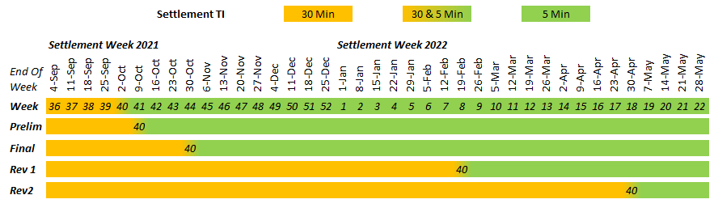
Transition Week and Beyond
This meeting is being recorded
5 Minute Settlements will start on the 1 October 2021
  1 October 2021 dissects settlement week 40
  There will be one set of settlements statements issues for settlement week 40
For settlement week 40 there will be 2 settlement cases created
  26 Sep to 30 Sep will be at 30 Minute Trading Intervals
  1 Oct to 2 Oct will be at 5 Minute Trading Intervals
Week 40 Preliminary statements are to be published on Friday 8 October
All settlements for trading days prior to 1 October 2021 will be settled in 30-minute Trading Intervals
  30-minute Trading intervals will continue to be provided in RM reports until 28 April 2022 (Week 40 R2)

Slide 25
Profiling Interval Metering Data
Paul Lyttle

Slide 26
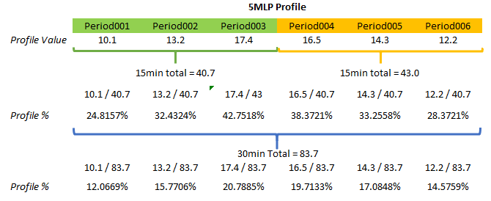
How to use the 5min load profiles (5MLP) in the RM20 report
This meeting is being recorded
Profiles are a set of values for each trading interval.
By using the values, the percentage allocation can be determined for any Interval period
Use the 5MLP to calculate the allocation percentage to profile to 5-minute trading intervals

Slide 27
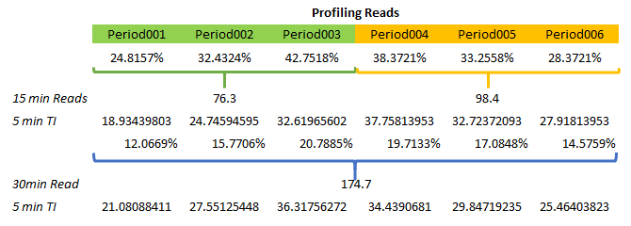
Interval reads can be profiled using the calculated percentages
This meeting is being recorded
  For the Interval Read apply the appropriate percentage for the corresponding period
  Calculate the value for each trading interval
Note: the above example is for illustration only, the actual profile values should be used instead of creating a percentage value to remove any rounding issues.

Slide 28
Known Defects
Simon Tu

Slide 29
Known 46.98 Production Defects
This meeting is being recorded
Retail Issue# | Report | Explanation | Defect | Fix Release Date
24 | RM26 | The MDP Substitution Estimation Report Response incorrectly included a DataType value – "ALL" which was not expected. Normally, the valid values are "Interval" or "Consumption". | 5216 | 1 October
81 | RM27 / RM21 | Level 2 Settlement Reconciliation Report, AEMO investigation has identified discrepancy in the logic used in the RM16 and the RM17 and RM27 (RM21) reports with regards to active meter reads during MDP churn. For RM17, RM21 RM27, only the MDP which is present in Standing Data (CNPR) at the settlement case run time is considered in the report output. For RM16 no specific check is undertaken to match the submitting MDP with the MDP in the Standing Data (CNPR). Given that a there have been 3 issues impacting the RM27/21 Level 2 Settlement Reconciliation reports (issues 81, 71, 48) to ensure the market has the full set of data to perform reconciliation, after the deployment of this fix, AEMO is planning on progressively re-running the RM27 for all open and closed settlement cases run since the 21st of June. AEMO requests subscribed participants to plan on how they will handle re-run RM27s to ensure their systems can handle the reissued reports whether they choose to ingest or ignore them. | 5616 | 1 October

Slide 30
Known 46.99 Known Defects
This meeting is being recorded
Retail Issue# | Report | Explanation | Defect | Fix Release Date
5 | ALL REPORTS | The report filename convention has been changed in the 5MS release for RM reports. This has impacted participants ability to easily identify what userID raised the RM Request. | 5337 | 27 October
N/A | RM13 | NMI Data streams History Report, The actors should only be able to view the details in the report based on their relationship with the NMI on the given settlement week. Participants (example FRMP) other then MDPs should get all meter reads irrespective of which MDP sent the reads. MDP however should only receive meter data they have provided. | 5670 | 27 October
N/A | ALL REPORTS | User can submit multiple RM Report Request with same transaction id. | 4612 | 27 October
79 | RM20 | Profile Shape Report, process exception encountered where the aseXML <From> Participant ID is in lower case. As a result of a code defect, the MDM is only processing the report request correctly if the <From> element is submitted in uppercase. | 5578 | 9 November

Slide 31
Notes
This meeting is being recorded
In response to questions asked, AEMO confirmed that:
  Re Retail Issue #81:
    There is a limitation to the RM21 report, where you need to specify the local retailer and TNI, at the moment you can’t request all the information for all TNI and Local Retailers – you have to raise them individually
    If the prelim was calculated pre-1 Oct (before the fix), the intention would be to run these reports again
      AEMO is seeking Industry feedback on this approach
      Feedback can be provided via AEMO’s bi-weekly Retail Issues sessions or via AEMO’s 5MS mailbox
  RM37 reports (Missing data report) will include information regarding any datastream in the CNDS table which is missing data for the reporting period e.g. E, B, Q, K datastreams
  AEMO will automated push the RM11, RM37, RM38 and RM39 to Participants
    The automation process is intended to start on 4 October 2021, this allows for any delayed data to be received prior to commencement of the report automation

Slide 32
Questions

Slide 33
Appendix

Slide 34
Other RM Reports

Slide 35
RM9 Actual Versus Estimate
This meeting is being recorded
What is the report?
  The Actual Versus Estimate report provides:
    A total number of reads, total number of non-actual reads and the % non actual for each settlement date
What is changing?
  No changes to this report

Slide 36
RM11 Missing Reads
This meeting is being recorded
What is the report?
  The Missing Reads report provides:
    A list of NMI datastream suffixes for each settlement date that does not have a read
What is changing?
  Includes the reporting of all active NMI datastream suffixes (this will include E, B, Q, K, etc. datastreams)
  Ability for AEMO to schedule this report to be run on a schedule for all MDP participant Ids

Slide 37
RM13 NMI Datastreams History
This meeting is being recorded
What is the report?
  The NMI Datastream History report provides:
    A History of all data provided to AEMO for settlements
      Report can be used to identify the version of reads used for settlements
What is changing?
  Increase in the number of read intervals relevant to the reads provided
    Period01 to Period48 (current) or
    Period 01 to Period96, or
    Period001 to Period288
  Increase in the decimal places for reads to reflect the MDFF precision.

Slide 38
RM22 Data Estimation
This meeting is being recorded
What is the report?
  The Data Estimation report provides data for:
    Each trading interval Substituted by AEMO where no read was available for the settlement period
What is changing?
  Increase in the number of Trading Intervals from 48 (Period01 to Period48) to 288 (Period001 to Period288)

Slide 39
RM26 MDP Substitute and Estimation
This meeting is being recorded
What is the report?
  The MDP Substitute and Estimation report provides:
    A list of NMIs for each Settlement Days where a substituted or estimated read will be used for settlements.
What is changing?
  The Quality Flag field will increate to match the reading intervals provided. (e.g. 48, 96, 288)

Slide 40
RM37 High Priority Missing Data
This meeting is being recorded
What is the report?
  The High Priority Missing Data report provides:
    A list of NMI datastream suffixes for each settlement date that does not have a read where the NMI is a Generator or connected to the Transmission Network
What is changing?
  This is a new report that is based on the RM11 Missing Reads
  Ability for AEMO to schedule this report to be run on a schedule for all MDP participant Ids

Slide 41
RM38 Datastream Missing Data
This meeting is being recorded
What is the report?
  The Datastream Missing Data report provides:
    A list of Channel read missing from the MDFF file compared to the Meter configuration where the NMI Datastream Suffix is Nx
What is changing?
  This is a new report to support channel level data
  Identifies where a reading is missing that may be required to support Net Settlement reads (e.g. missing E1 or B1 reads)

Slide 42
RM39 Mismatch Data
This meeting is being recorded
What is the report?
  The Mismatch Data report provides:
    A list of NMIs or Datastreams that do not exist in the CATS standing data
What is changing?
  This is a new report to support channel level data
  Identifies NMIs that have not been created in the CATS standing data
  Identifies Datastreams that do not match the CATS standing data.

